Slide 1


BOSTON PROPERTY ANALYSIS DASHBOARD PROJECT
Presented By: Razab Bharti

Slide 2
Problem statement and source of data
The dataset is taken from Kaggle. Dataset is of the properties in Boston.
The dataset contains 507 observations and 14 fields.
We are trying to analyze the properties vs Crime rate in Boston.
Analyzing the data, many questions are answered and charts are plotted, on dashboard, to corresponding answers.
Dataset contains columns like RM(room), NOX(Nitric Oxide), age, mede(price),etc.

Slide 3
Basic Analysis :
We first compared the price with respect to average nitric oxide.
Now after this, we compare the price of property with crime in the area.
We have also compared the flow of price with crime rate and analyzed that price gets increased where the crime rate is less.
We also compared the price with other dynamic measures of the area like the age of the property, and analyzed that price varies as the factor varies.

Slide 4
QUESTIONS
Q.No. 1. Price in comparison with average Nitrogen Oxide.
Q.No. 2. Price vs crime in area.
Q.No. 3. Crime measurement.
Q.No. 4. Crime(3 bin) vs price.
Q.No. 5. Price vs dynamic measure (age, crime, lstat, nox,r).
Q.No. 6. Flow of price with crime rate
Q.No. 7. Overall value of records for property with price range

Slide 5
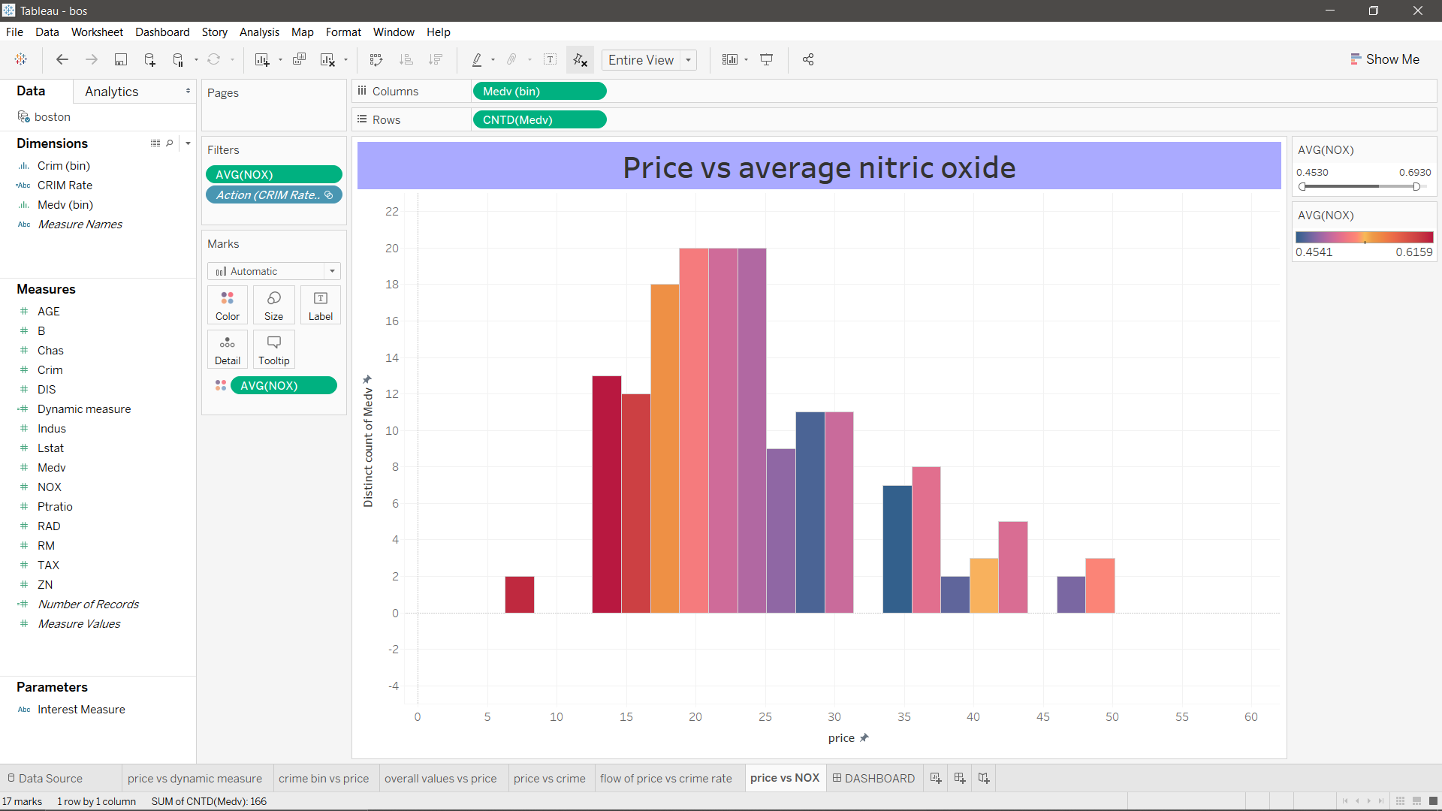
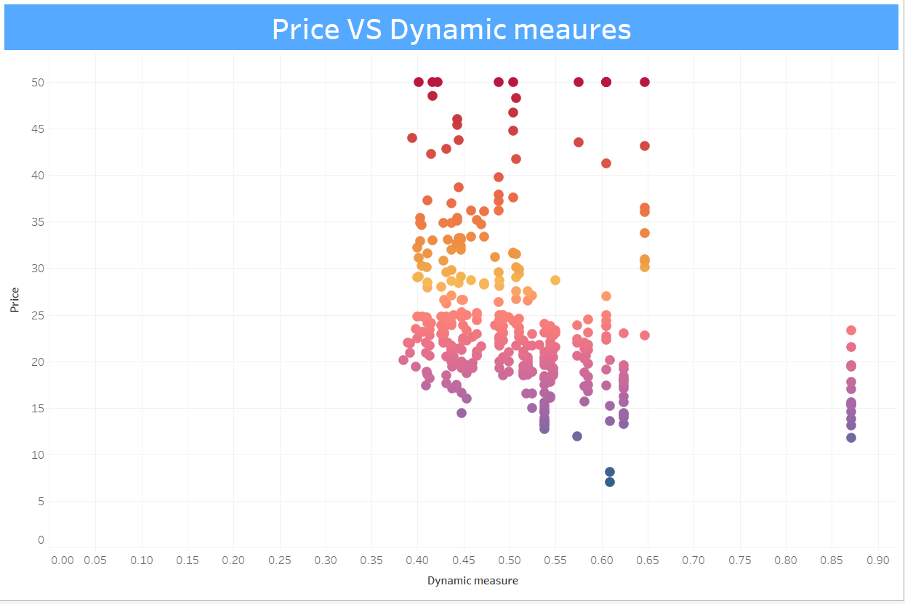
Examples of chart visuals :

Slide 6
Conclusion
After analyzing and comparing prices of different properties with respect to different factors like crime rate, Nitric Oxide, etc. we came to conclude that prices of the property are higher at the places where crime rate is low and vice versa. And thus with Nitric oxide.
Video link:
https://drive.google.com/open?id=1_F0uvtWzw4G2PUAKsxQ78EcAPFGjjsvb
Notes:
HELLO

Slide 7
Thank You

